Slide 1


Slide 2
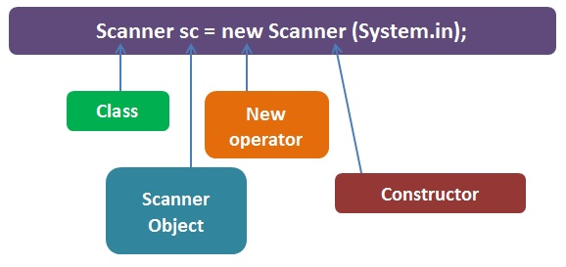

Slide 3
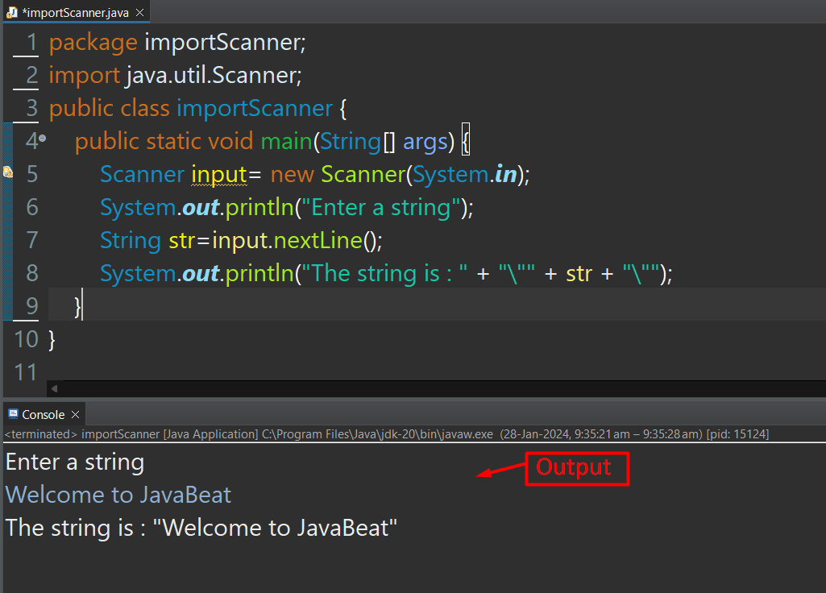

Slide 4
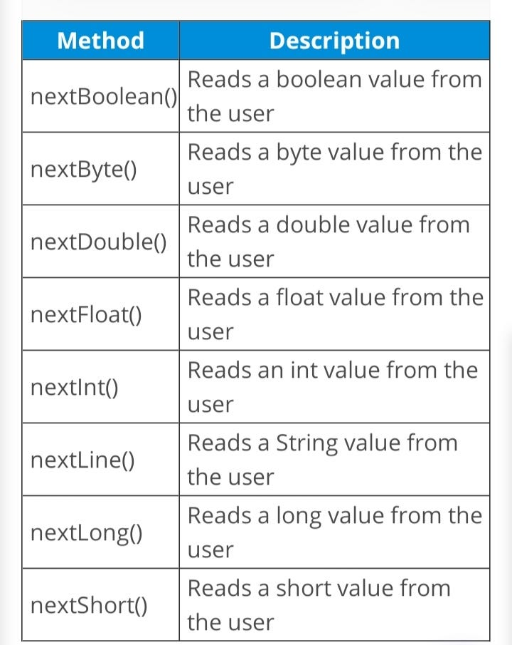

Slide 5
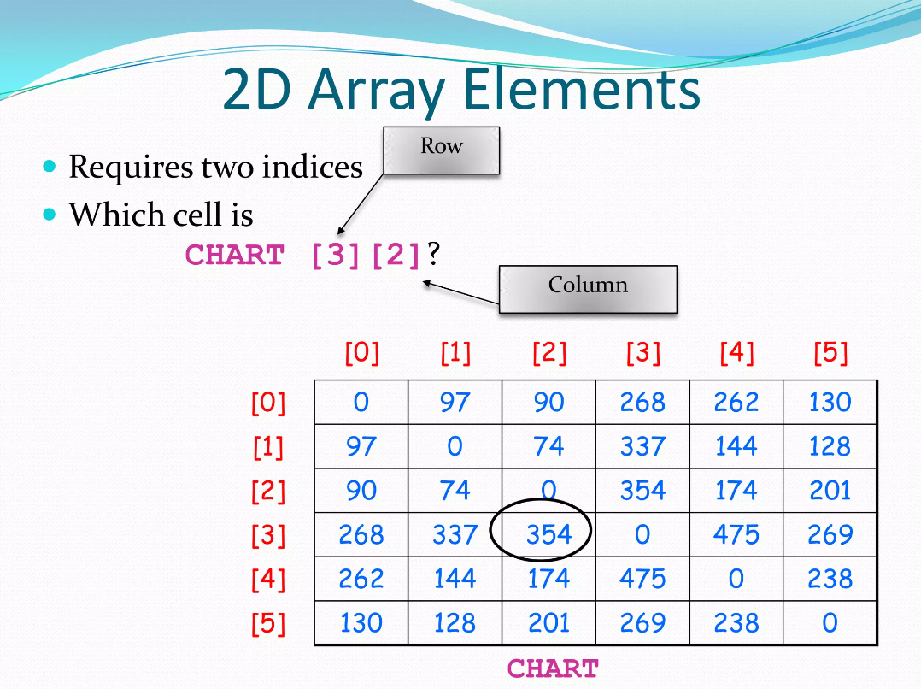

Slide 6
dataType[][] arrayName = new dataType[rows][columns];
int[][] matrix = new int[3][4];
double[][] matrix = new double[2][3];
int[][] matrix = {{1, 2, 3}, {4, 5, 6}, {7, 8, 9}};

Slide 7
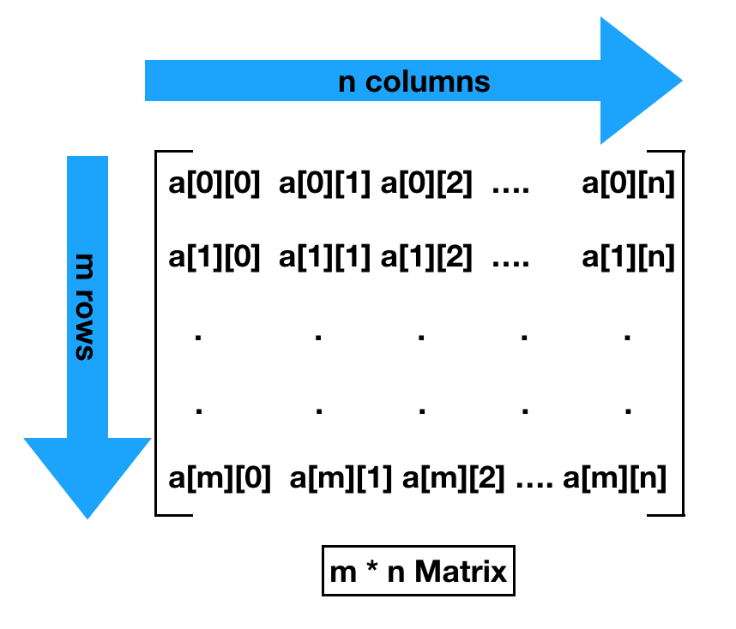

Slide 8
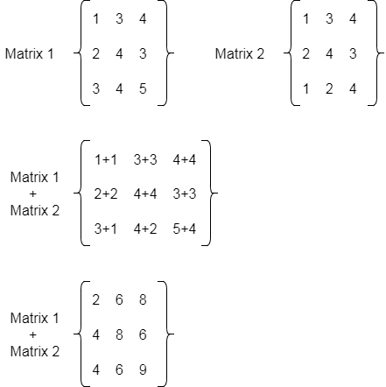

Slide 9
public class MatrixExample {
public static void main(String[] args) {
int[][] matrix = {{1, 2, 3}, {4, 5, 6}, {7, 8, 9}};
// Get the number of rows and columns in the matrix
int numRows = matrix.length;
int numCols = matrix[0].length;
// Iterate through the matrix and print each element
for (int i = 0; i < numRows; i++) {
for (int j = 0; j < matrix[i].length; j++) {
System.out.print(matrix[i][j] + " ");
}
System.out.println(); // Move to the next line after printing each row
}
}
}

Slide 10
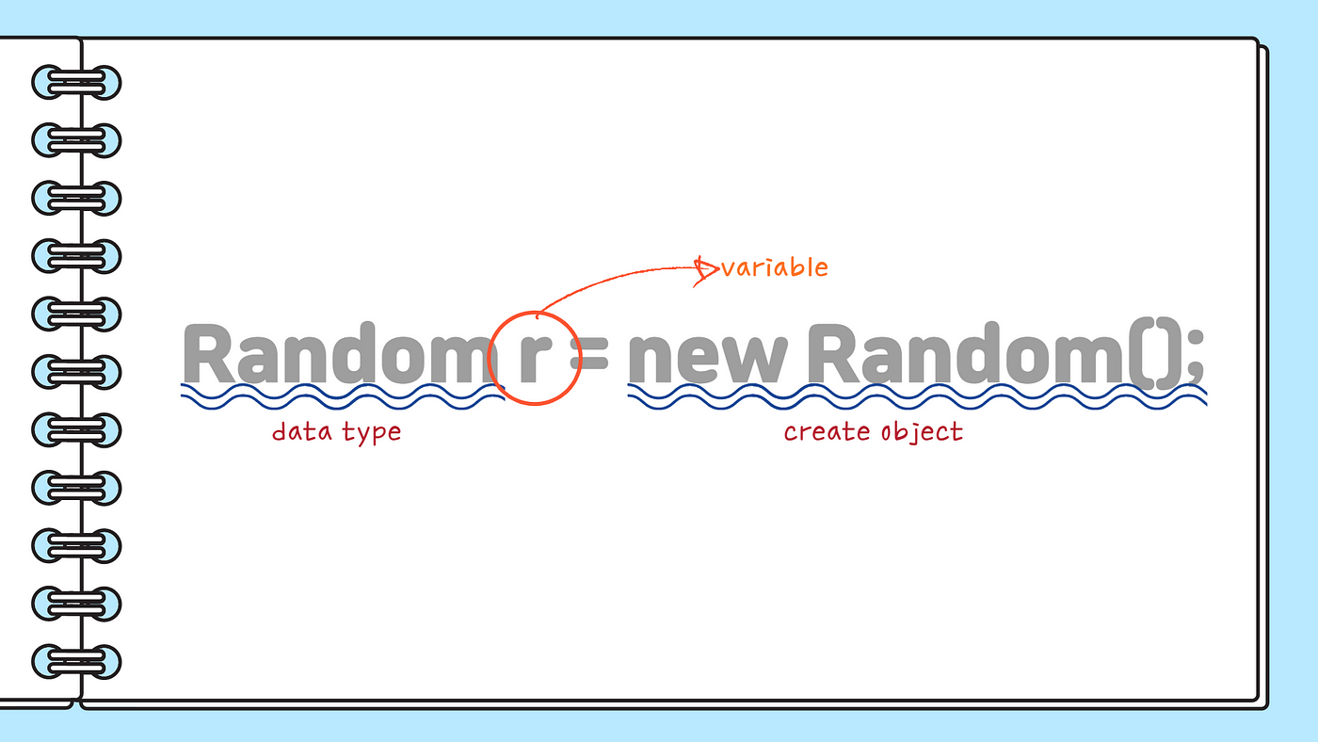

Slide 11
import java.util.Random;
public class RandomExample {
public static void main(String[] args) {
Random random = new Random();
// Generate a random integer between 0 (inclusive) and 100 (exclusive)
int randomNumber = random.nextInt();
int randomNumberInRange = random.nextInt(100);
double randomDouble = random.nextDouble();
System.out.println("Random number: " + randomNumber);
}
}

Slide 12
import java.util.Random;
public class RandomExample {
public static void main(String[] args) {
Random random = new Random();
// Generate a random integer between 12 and 24 (inclusive)
int lowerBound = 12;
int upperBound = 25; // Note: upperBound is exclusive in nextInt method
int randomNumber = random.nextInt(upperBound - lowerBound) + lowerBound;
System.out.println("Random number between 12 and 24: " + randomNumber);
}
}

